Slide 1
Types of Aqueducts used in the Catskill System
Back to Aqueducts

Slide 2
Types of Aqueducts on Hydraulic Grade
following natural surface
open channel
cut-and-cover
above natural surface
embankment
viaduct
below natural surface
grade tunnel
Back to Aqueducts

Slide 3
Types of Aqueducts below Hydraulic Grade
Following or above natural surface
wooden pipe
reinforced concrete pipe
steel pipe
plastic pipe
below natural surface
pressure tunnel
Back to Aqueducts

Slide 4
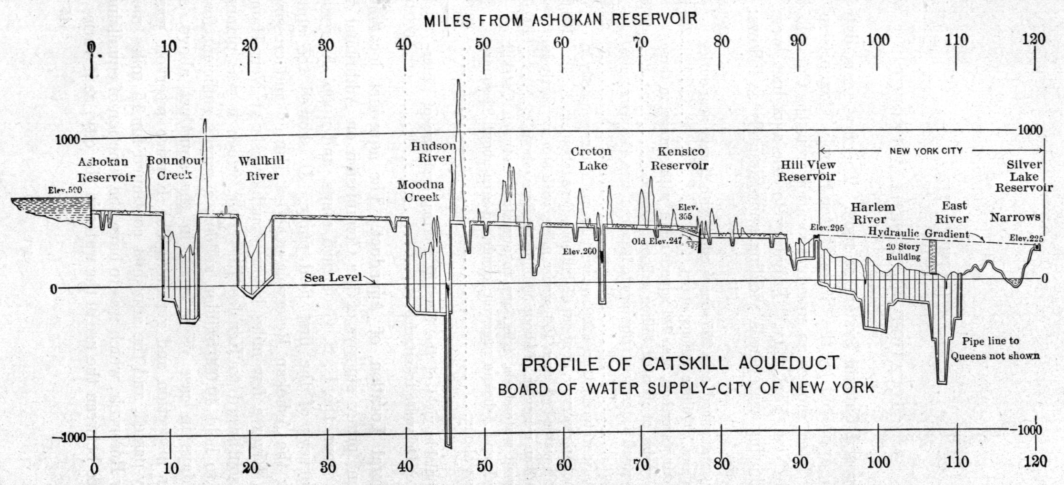
Profile of Catskill Aqueduct
Back to Aqueducts
Small Scale profile of Catskill Aqueduct, Ashokan Reservoir to Silver Lake Reservoir. (White p. 46)

Slide 5
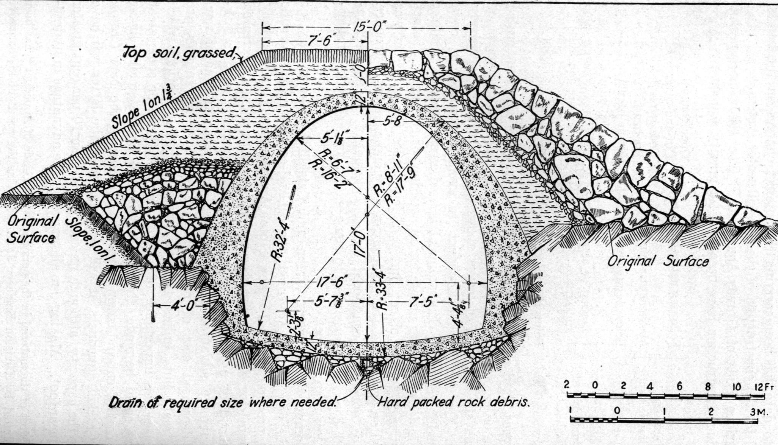
Cross-section of Cut-and-cover Aqueduct
Back to Aqueducts
Construction of cover embankment. Rock was usually excavated to a 6 on 1 slope. Minimum thickness of concrete along sides 20 ins., but usually thicker owing to disintegrated condition of surface rocks. (White p. 50)

Slide 6
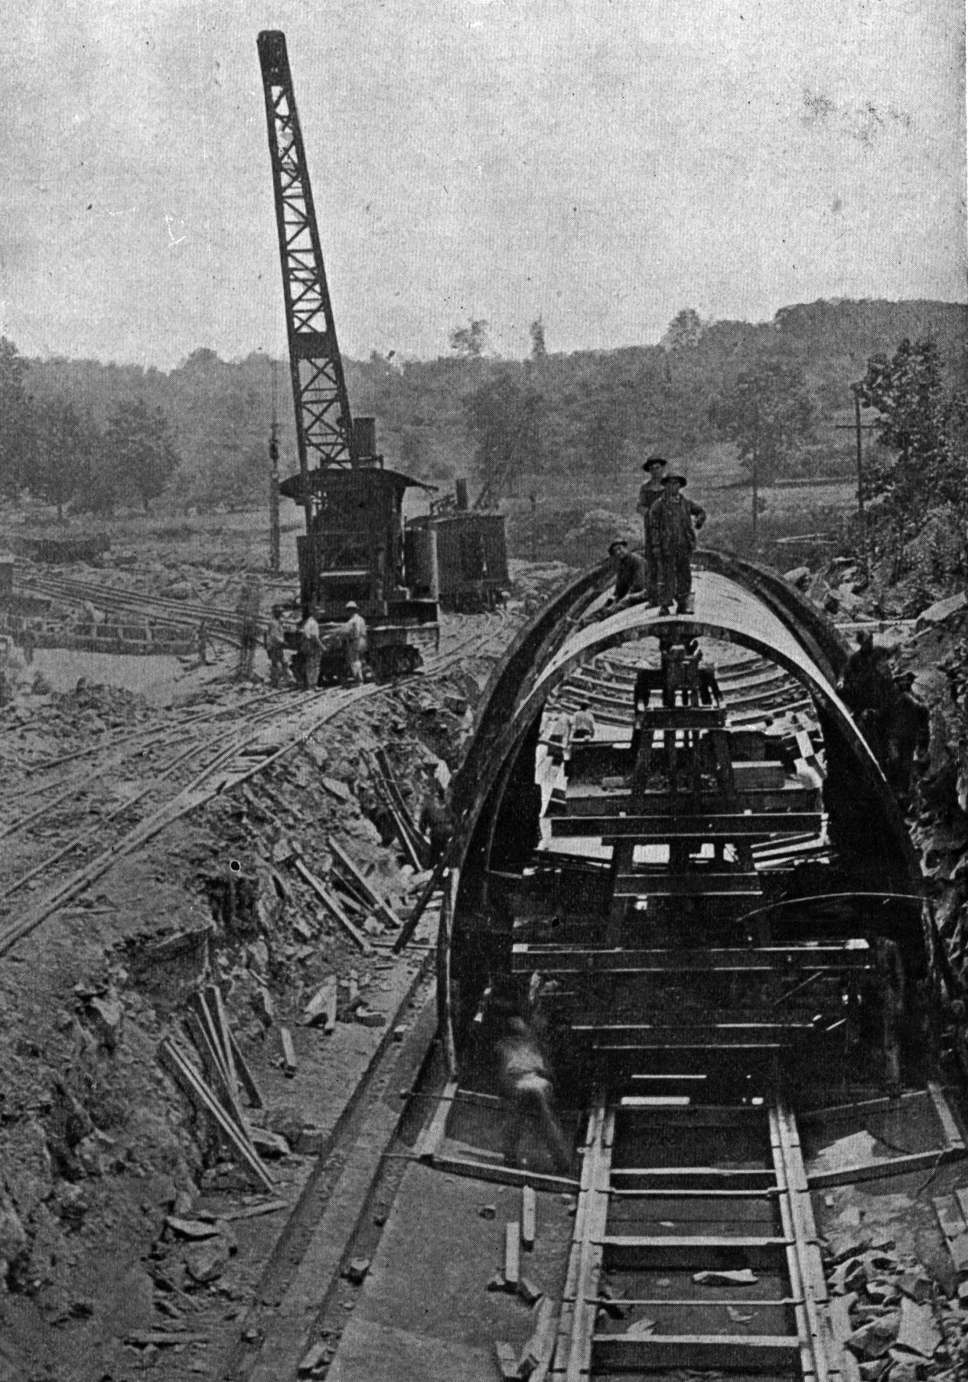
Construction of Cut-and-cover aqueduct
Shows steel form and carriage; also locomotive crane used to place concrete, move outside forms, and assist in excavation. (White p. 220)
Back to Aqueducts

Slide 7
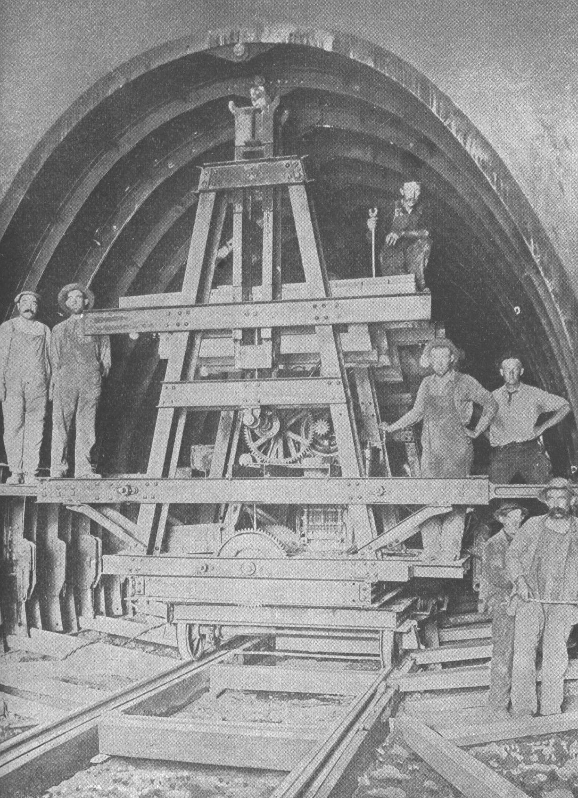
Electric carriage for moving interior forms
Carriage and upper jacks are motor driven. Side jacks and turntable hand driven. (White p. 221)
Back to Aqueducts

Slide 8
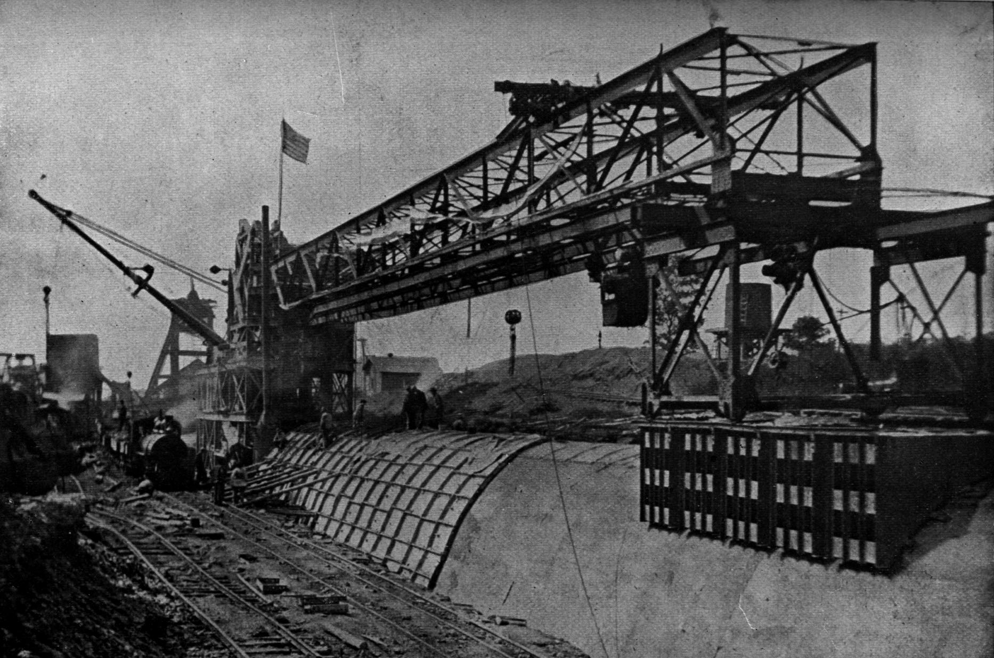
Traveling aqueduct building plant
Back to Aqueducts
Traveling crushing concrete, mixing, and form-moving plant completing last section of aqueduct adjoining shaft 1 of contract 12. This plant built 7500 feet of aqueduct in two seasons. (White p. 223)

Slide 9
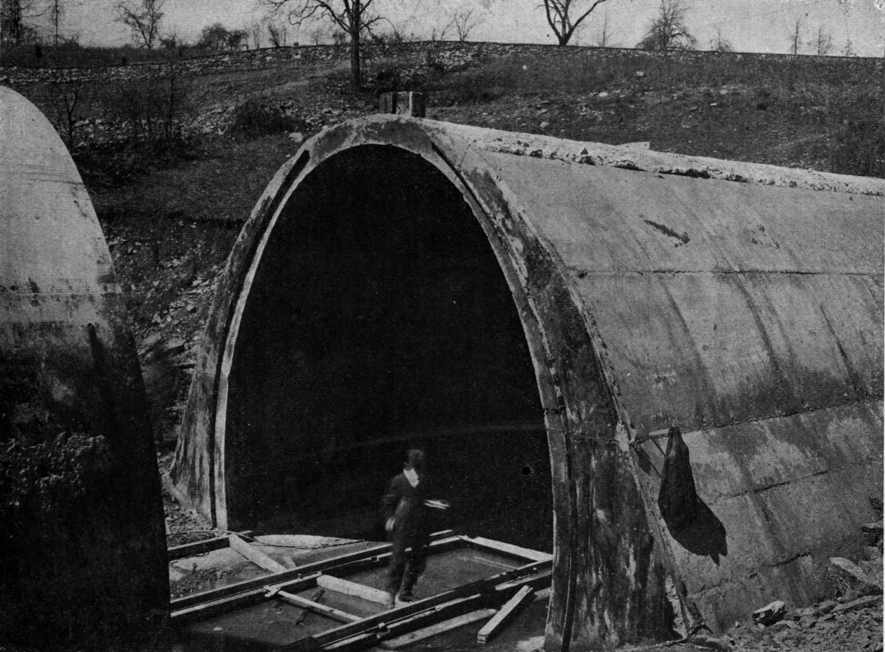
Cut-and-cover Arch
This section was
cast between steel
forms with steel plate in expansion joints at 60-ft intervals. Steel plates 6” x 3/8” were places in both invert and arch joints to act as water stops. (White p. 236)
Back to Aqueducts

Slide 10
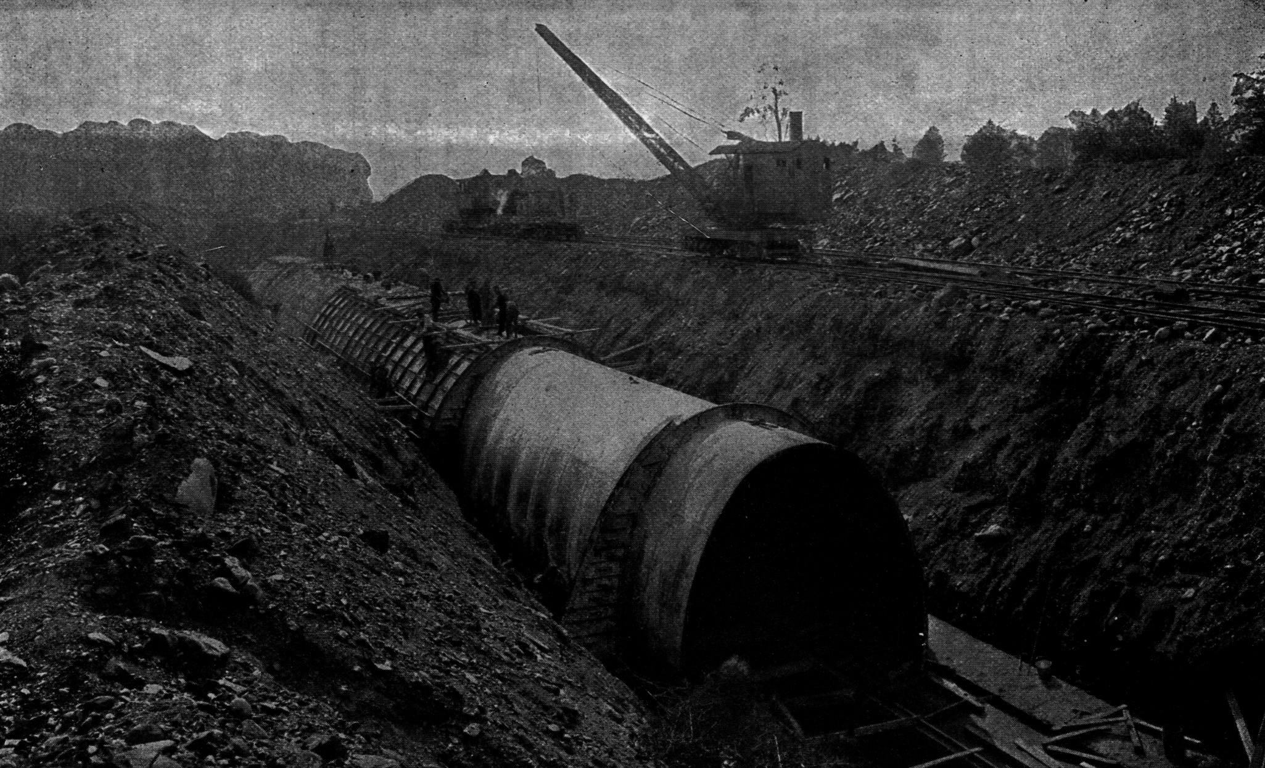
Steel forms and locomotive crane
Continuous method was here used, forms being used “telescoping.” 60- to 75-foot section concreted daily. (White p. 374)
Back to Aqueducts

Slide 11
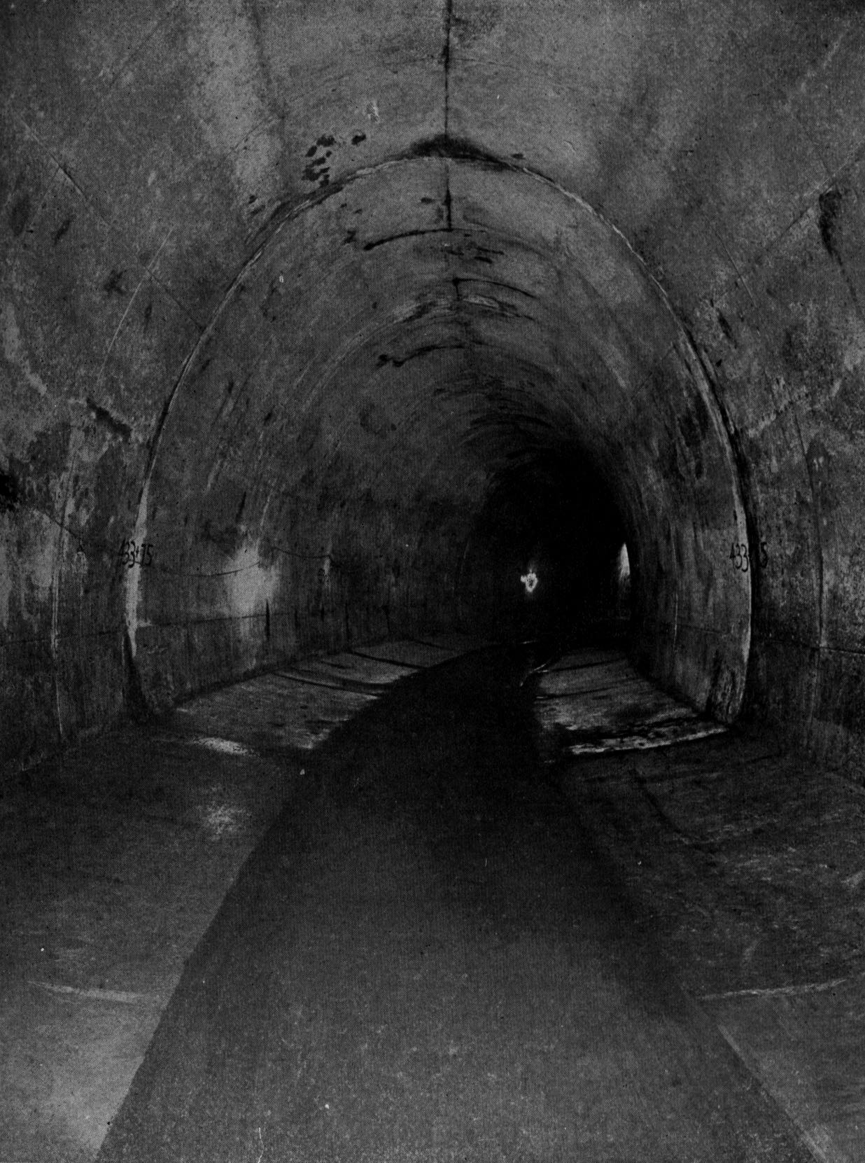
Cut-and-cover Aqueduct on Curve
Arch cast with aid of steel forms built wedge-shaped in 5-foot lengths to 200 feet radius. Section 17 feet high by 17 feet 6 inches wide. (White p. 237)
Back to Aqueducts

Slide 12
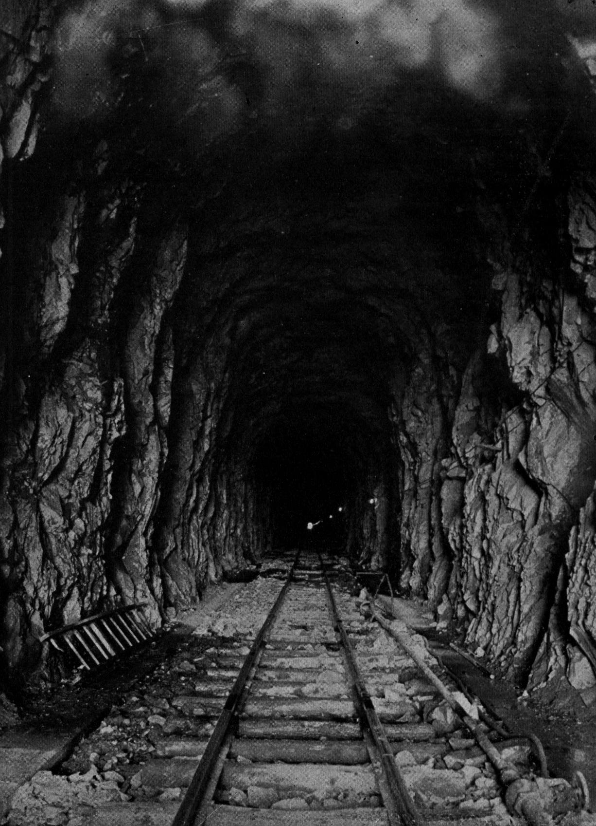
Peak Tunnel (grade tunnel) ready for concrete lining
Footing courses are in place. Center track for hauling material to upper portion of contract 11. Tunnel is 3450 feet long on tangent.(White p. 243)
Back to Aqueducts

Slide 13
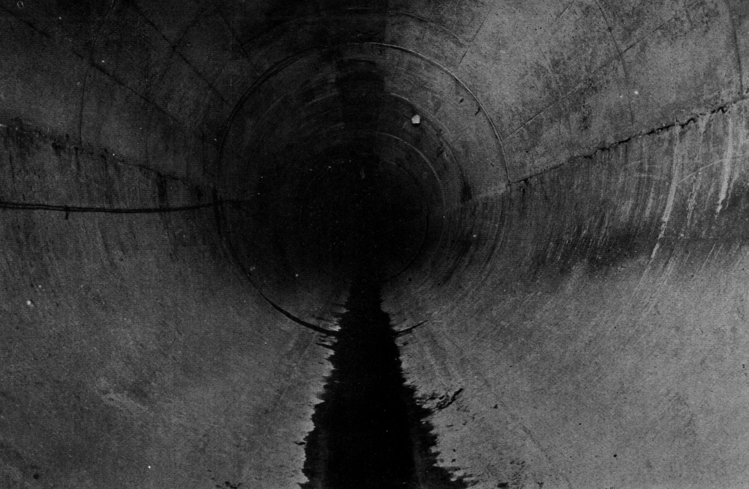
Completed pressure tunnel lining
Back to Aqueducts
Note smooth finish and close joints at invert and springing line. Concrete surface very dry under ground water bend. (White p. 331)

Slide 14
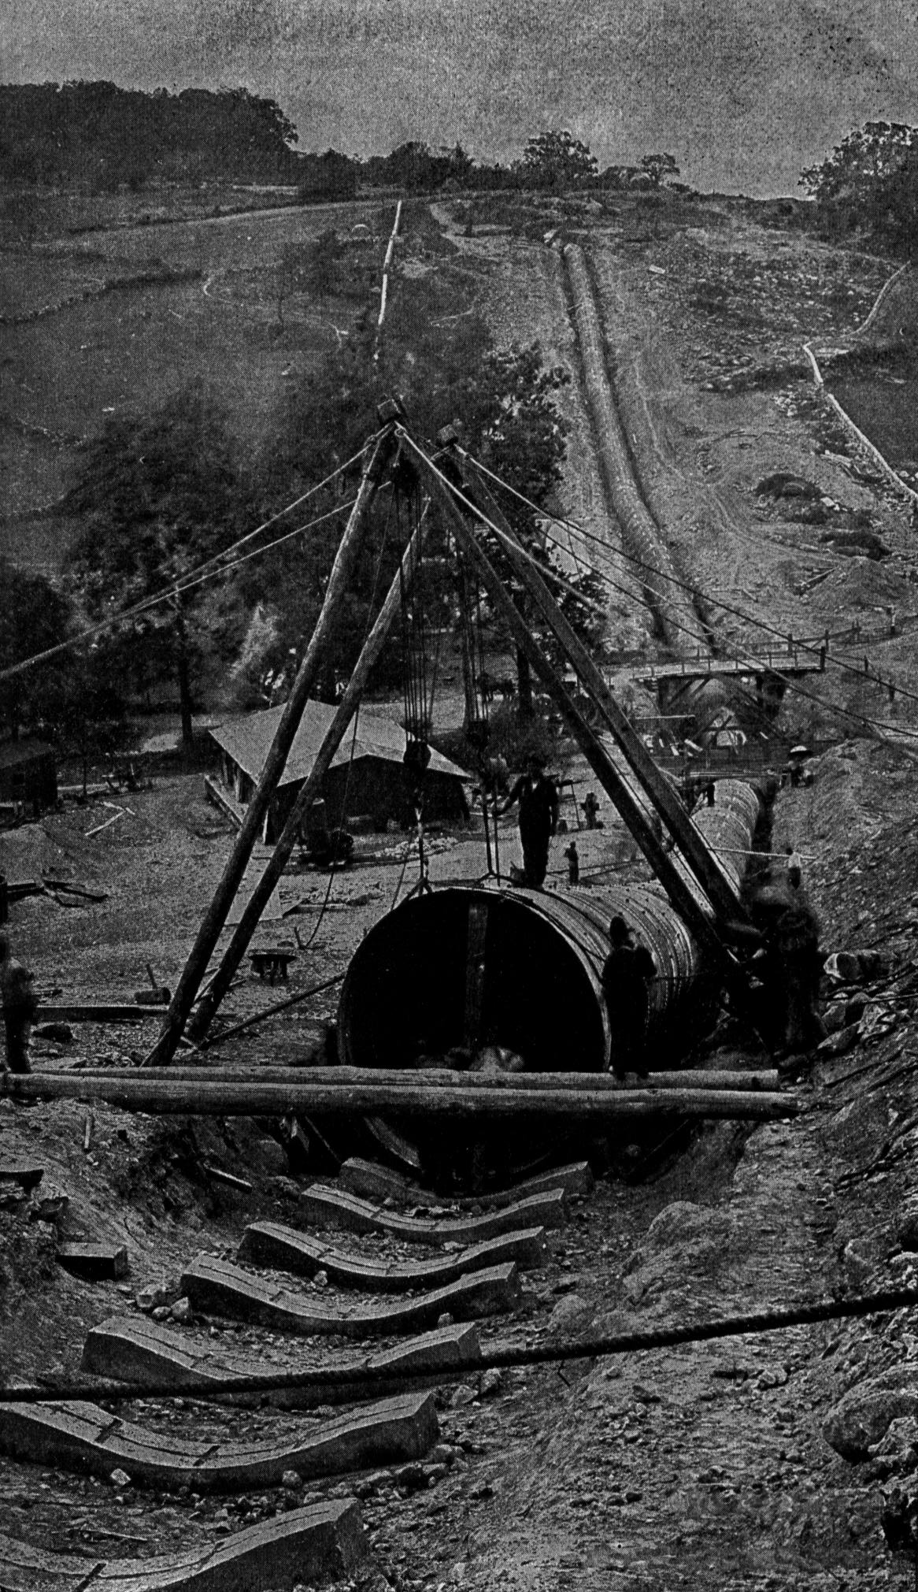
Hunters Brook Steel Pipe Siphon
Laying of steel pipe on concrete pedestal blocks. Later pipe was filled with water, covered with concrete and earth and lined with 2 ins. of mortar. (White p. 467)
Back to Aqueducts

Slide 15
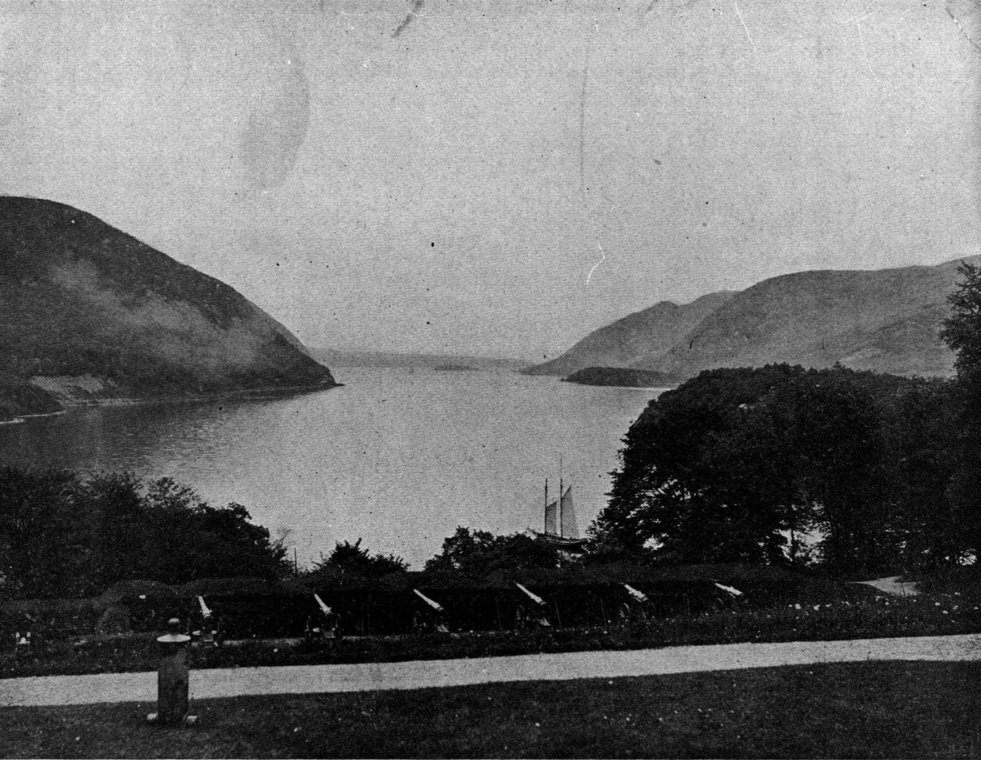
Hudson River Crossing
View from West Point of Hudson River at Storm King and Breakneck, where Catskill Aqueduct Crosses 1100 feet below surface of river. (White p. 406)
Back to Aqueducts

